Slide 1
CS4100: Computer Architecture Instructions: Language of the Computer (II)
Prof. Chung-Ta King
Department of Computer Science
National Tsing Hua University, Taiwan
(Adapted from textbook slides https://www.elsevier.com/books-and-journals/book-companion/9780128122754/lecture-slides)

Slide 2
Outline
Languages of computers (Sec. 2.1)
Operations of computer hardware (Sec. 2.2)
Operands of computer hardware (Sec. 2.3, 2.4)
Registers, memory, signed and unsigned numbers
Representing instructions (Sec. 2.5)
More operations: logic, decision making (Sec. 2.6, 2.7)
Supporting procedures in hardware (Sec. 2.8)
More operand representations (Sec. 2.9, 2.10)
Characters, wide immediates and addresses
Parallelism and instructions (Sec. 2.11)
Translating and starting a program (Sec. 2.12)

Slide 3
Outline
A C sort example to put it all together (Sec. 2.13)
Arrays versus pointers (Sec. 2.14)
Compiling C and interpreting Java (Sec. 2.15)
Other ISAs: MIPS, x86 (Sec. 2.16, 2.17)
The rest of RISC-V (Sec. 2.18)
Fallacies and pitfalls (Sec. 2.19)

Slide 4
Outline
Supporting procedures in hardware (Sec. 2.8)
More operand representations (Sec. 2.9, 2.10)
Characters, wide immediates and addresses
Parallelism and instructions (Sec. 2.11)
Translating and starting a program (Sec. 2.12)
A C sort example to put it all together (Sec. 2.13)
Arrays versus pointers (Sec. 2.14)
Compiling C and interpreting Java (Sec. 2.15)
Other ISAs: MIPS, x86 (Sec. 2.16, 2.17)
The rest of RISC-V (Sec. 2.18)
Fallacies and pitfalls (Sec. 2.19)

Slide 5
Procedures/Functions in HLL
Procedure/function calls change control flow
Must specify:
Procedure address
Arguments
Local variables
Return value
Return address
...
c = sum(a,b);
...
Caller
Callee
int sum(int x, int y) { int temp;
temp = x + y;
return temp; }
Where to put these data?
How to translate into machine code?

Slide 6
Procedures/Functions in HLL
Requirements:
Procedure internals are treated as a black box
Memory allocation of callee’s internal (local) variables should not “interfere” outside data, including other invocations of the same procedure, i.e., recursive calls
Control flow can jump to and return from procedure (procedure address and return address)
Caller data can be passed to and returned from procedure (arguments and return value → values in C/C++, not memory locations!)
int sum(int x, int y) { int temp;
temp = x + y;
return temp; }

Slide 7
From C to Machine Code in Memory
0
…
addi x9,x0,x
x20 ← x
ld x20,0(x9)
...
x = x + 5;
...
y = y + 5;
... z = z + 5;
...
addi x20,x20,5
x20 ← x20 + 5
sd x20,0(x9)
x ← x20
…
addi x9,x0,y
x21 ← y
ld x21,0(x9)
addi x21,x21,5
x21 ← x21 + 5
sd x21,0(x9)
y ← x21
…
x
Note: for illustration purpose only; RISC-V does this differently
y
Assume 32-bit RISC-V
…
2³² - 1

Slide 8
Implement It with a Procedure
0
…
? ← x
jump add5
x ← ??
...
x = add5(x);
...
y = add5(y);
... z = add5(z);
...
add5(int w){
return w + 5;
}
call add5(x)
...
? ← y
jump add5
y ← ??
call add5(y)
…
add5:
addi x9,x0,?
x21 ← x,y,z, …
ld x21,0(x9)
addi x21,x21,5
x21 ← x21 + 5
addi x9,x0,??
return ← x21
sd x21,0(x9)
x
Why not call-by-reference?
y
?
argument
??
…
“working space” of add5()
return value
2³² - 1

Slide 9
How about Recursive Procedures?
0
…
Why such a case?
...
y = fact(x);
...
...
fact(int n){
int temp;
temp = fact(n-1);
return temp * n;
}
? ← x
call fact
y ← ??
…
fact:
? ← ? - 1
Multiple instances of fact() “alive” at the same time!
call fact
temp ← ??
?? ← temp * ?
…
x
y
?
X
Each needs own working space
??
…
2³² - 1

Slide 10
“Working Space” of “Alive” Procedures
Every “alive” procedure/function must have its own working space, i.e. memory space for all the variables that it works on
Compiler knows size and contents of working space
Whenever a procedure is called, compiler generates some machine code to allocate its working space
How to pass the address of working space to the procedure?
Live procedures are called first-in-last-out, so a nature way of managing “working space” is a stack
Added benefit: all alive procedures of same procedure (e.g., fact()) can run using the same code with own separate working space, referenced to by stack pointer register (SP)

Slide 11
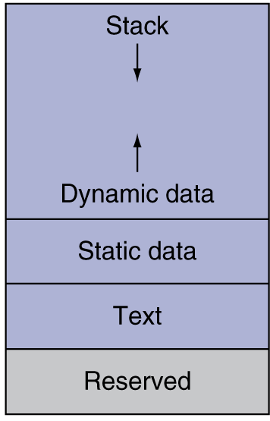
Procedures/Functions in HLL
General strategies:
Compiler allocates all memory required of a procedure in program stack (pointed to by stack pointer register SP)
Typical memory layout seen by each program (compiler generates code to allocate and manage the stack)
Use registers to transfer addresses and data as much as possible
c = sum(a,b);
...
int sum(int x, int y) { int temp;
temp = x + y;
return temp; }
Notes:
What if not? Consider a recursive function.
foo() {
temp = …;
foo();
… = …temp…;
}

Slide 12
Use Registers to Pass Arguments
...
x = add5(x);
...
y = add5(y);
...
add5(int w){
return w + 5;
}
0
…
? ← x
jump add5
x ← ??
call add5(x)
...
? ← y
jump add5
y ← ??
call add5(y)
…
add5:
addi x9,x0,?
x21 ← ?
ld x21,0(x9)
addi x21,x21,5
x21 ← x21 + 5
addi x9,x0,??
?? ← x21
But wait …
How about separate working spaces?
sw x21,0(x9)
x
? and ?? can be mapped to registers instead of memory
y
?
Back up reg. before use!
Where? stack!
??
…
2³² - 1
Notes:
This is a tradeoff between execution speed (via registers) and correctness

Slide 13
Summary: Procedure Call in RISC-V
Caller:
1) Place arguments in registers (x10 to x17)
2) Jump to beginning of procedure
Callee:
3) Allocate storage on program stack
4) Perform procedure’s operations
5) Place result in register (x10) for caller
6) Return to place of call at caller
Caller:
7) Get return result from register (x10)
Use registers to communicate between caller and callee as much as possible
Also need to backup and restore registers so that caller will not know

Slide 14
Procedure Call Instructions
Procedure call: jump and link
jal x1,ProcedureLabel
Address of following instruction put in x1 (PC + 4)
Jumps to address ProcedureLabel by loading into PC
Why have a jal? Make the common case fast: functions are very common
Procedure return: jump and link register
jalr x0,0(x1)
Like jal, but jumps to 0 + address in x1
Use x0 as rd (hardware still tries to put PC + 4 into x0, but x0 cannot be changed)
Can also be used for computed jumps, e.g., for case/switch

Slide 15
Leaf Procedure Example
C code:
long long int leaf_example ( long long int g, long long int h, long long int i, long long int j) { long long int f; f = (g + h) - (i + j); return f; }
Arguments g, h, i, j in x10 ~ x13
Local variable f in x20 (assigned by the compiler)
Temporaries x5, x6 (assigned by the compiler)
Result value in x10
Need to save x5, x6, x20 on stack in case caller uses them
Notes:
In this book, pointers are all 64 bits and declare all C integers as long long int to keep them the same size. Also declare variables used as indexes to arrays to be size_t, which guarantees they are the right size no matter how big the array. They are typically declared the same as long int.

Slide 16
Leaf Procedure Example
RISC-V code:
leaf_example: addi sp,sp,-24
sd x5,16(sp)
sd x6,8(sp)
sd x20,0(sp)
add x5,x10,x11
add x6,x12,x1
sub x20,x5,x6
addi x10,x20,0
ld x20,0(sp)
ld x6,8(sp)
ld x5,16(sp)
addi sp,sp,24
jalr x0,0(x1)
Assembler changes sp to x2
save x5, x6, x20 on stack
x5 = g + h
x6 = i + j
f = x5 – x6
copy f to return register
retsore x5, x6, x20 from stack
return to caller

Slide 17
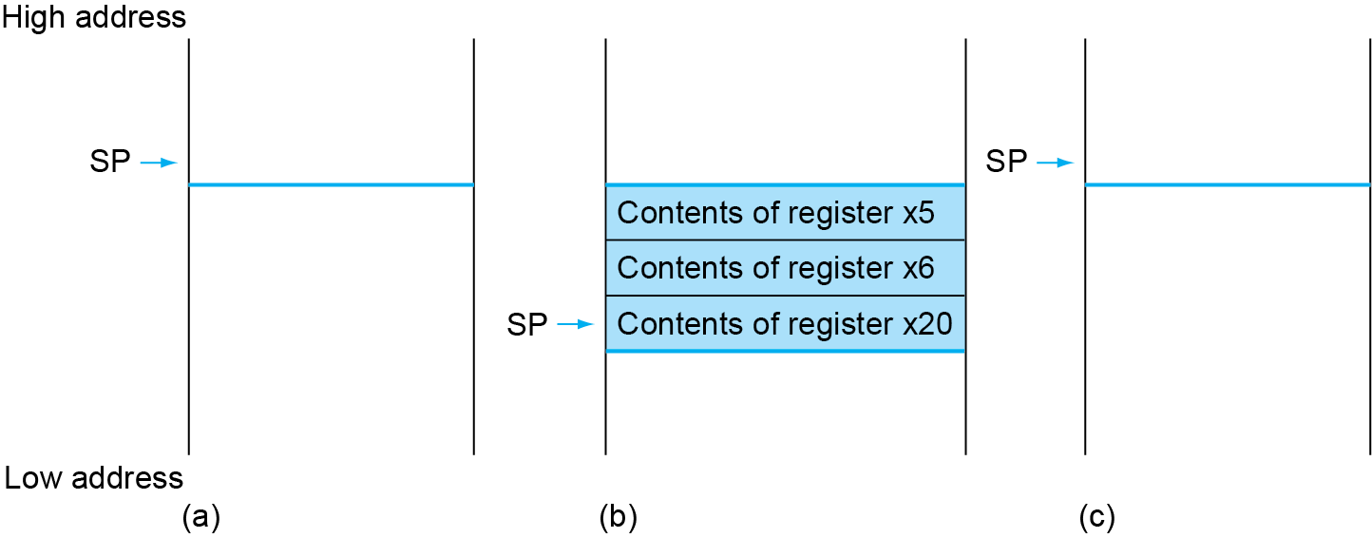
Preserving Register Contents on the Stack
Before invocation
During execution
After return
Fig. 2.10
Space allocated specifically for this invocation of the procedure

Slide 18

RISC-V Procedure Call Convention
Register | ABI Name | Description | Saver
x0 | zero | Hard-wired zero | ---
x1 | ra | Return address | Caller
x2 | sp | Stack pointer | Callee
x3 | gp | Global pointer | ---
x4 | tp | Thread pointer | ---
x5 | t0 | Temporary/alternate link register | Caller
x6~x7 | t1~t2 | Temporaries | Caller
x8 | s0/fp | Saved register/frame pointer | Callee
x9 | s1 | Saved register | Callee
x10~x11 | a0~a1 | Function arguments/return values | Caller
x12~x17 | a2~a7 | Function arguments | Caller
x18~x27 | s2~s11 | Saved registers | Callee
x28~x31 | t3~t6 | Temporaries | Caller
Fig. 2.1
Notes:
application binary interface (ABI)
This convention is another example of making the common case fast: most procedures can be satisfied with up to eight argument registers, twelve saved registers, and seven temporary registers without ever going to memory.

Slide 19
Procedure Call Convention
... sum(a,b)...;
long long int sum(long long int x,
long long int y) {
long long int temp;
temp = x + y; return temp; }
Return address ra (x1)
Procedure address Labels
Arguments a0~a7 (x10~x17)
Local variables t0~t6 (x5~x7,x28~x31)
Return value a0,a1 (x10,x11)
Why such convention?

Slide 20
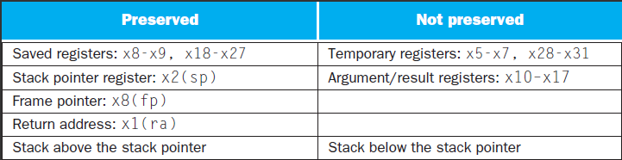
Why Procedure Convention Important?
As a contract between caller and callee, so that
People who have never seen or even communicated with each other can write functions that work together
Preserved: if used, callee saves and restores them in stack
Not preserved: callee uses them freely without preserving
So if caller needs them after the call, it has to preserve them
Fig. 2.11
Based on this convention, x5, x6 in leaf procedure example need not be saved

Slide 21
Non-Leaf Procedures
Procedures that call other procedures
For nested calls, caller needs to save on the stack:
Its return address
Any arguments and temporaries needed after the call
Restore from the stack after the call
Example C code:
long long int fact(long long int n) { if (n < 1) return 1; else return n * fact(n - 1); }
Argument n in a0 (x10)
Result value in a0 (x10)

Slide 22
Non-Leaf Procedure Example (RISC-V Code)
fact: addi sp,sp,-16 // make space on stack sd x1,8(sp) // save return address in x1 onto stack sd x10,0(sp) // save argument in x10 onto stack addi x5,x10,-1 // x5 = n – 1 bge x5,x0,L1 // if n >= 1, go to L1 addi x10,x0,1 // else, set return value to 1 addi sp,sp,16 // pop stack, don’t bother restoring values jalr x0,0(x1) // return L1: addi x10,x10,-1 // n = n – 1 jal x1,fact // call fact(n – 1) addi x6,x10,0 // move return value of fact(n – 1) to x6 ld x10,0(sp) // restore caller’s n ld x1,8(sp) // restore return address addi sp,sp,16 // return space on stack mul x10,x10,x6 // return n * fact(n – 1) jalr x0,0(x1) // return

Slide 23
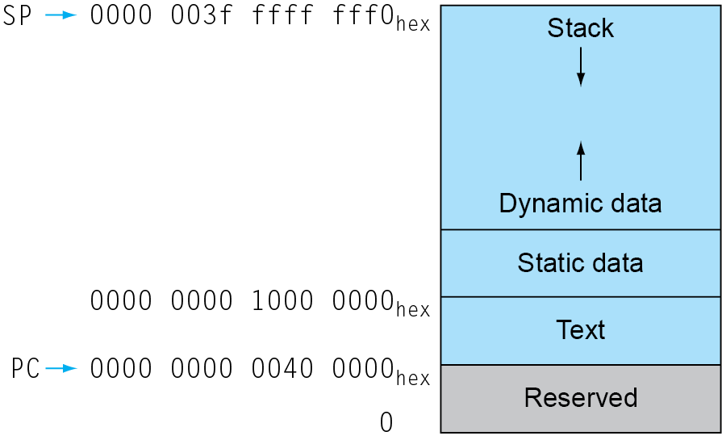
Typical Memory Layout of a Program
Compilers allocate (map) variables to memory based on this view for each and every program
Text: program code
Static data: global variables
e.g., static variables in C, constant arrays, strings
x3 (global pointer, gp) initialized to address allowing ±offsets into this segment
Dynamic data: heap
e.g., malloc() and free() in C, new in Java
Stack: automatic storage (local variables)
gp
Fig. 2.13
Notes:
How many “programs” can be executed in a computer at the same time?
The user address space is set to 2^38 of the potential 2^64 total address space given a 64-bit architecture.

Slide 24
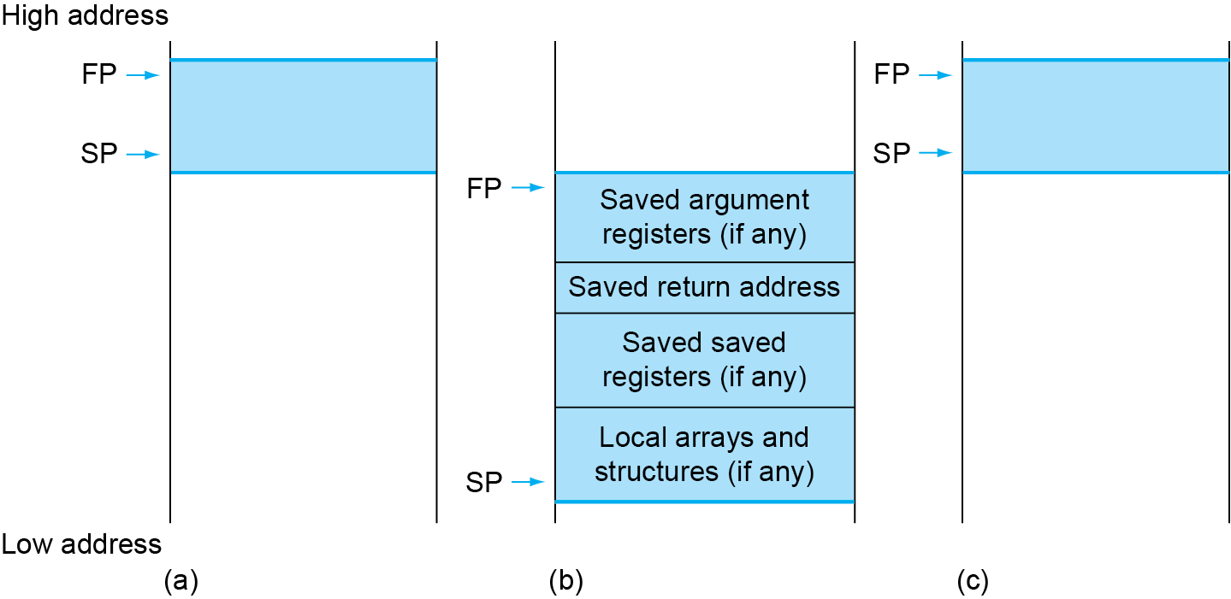
Local Data on the Stack
Local data allocated by callee, e.g., local array, in stack
Procedure frame (activation record): fp
“Working space” of the procedure, compiler generates
Fig. 2.12
Notes:
The working space of a procedure, all the storage requirements of a procedure → all necessary code generated by compiler
Why not use $sp, but introducing $fp instead?
Since the stack pointer may change during program execution, it’s easier for programmers to reference variables via the stable frame pointer, although it could be done just with the stack pointer and a little address arithmetic. If there are no local variables on the stack within a procedure, the compiler will save time by not setting and restoring the frame pointer. When a frame pointer is used, it is initialized using the address in sp on a call, and sp is restored using fp.

Slide 25
Summary: Procedure Calls
Compiler (or assembly programmer) and processor hardware work together to support/translate procedure calls in HLLs
Processor hardware provides:
Registers: SP (stack pointer), RA (return address), …
Instructions: jal, jalr
Compiler does
Allocation of memory space for stack and local variables
Generation of instructions for managing stack, passing arguments and return values, jumping to and returning from procedure

Slide 26
Outline
Supporting procedures in hardware (Sec. 2.8)
More operand representations (Sec. 2.9, 2.10)
Characters, wide immediates and addresses
Parallelism and instructions (Sec. 2.11)
Translating and starting a program (Sec. 2.12)
A C sort example to put it all together (Sec. 2.13)
Arrays versus pointers (Sec. 2.14)
Compiling C and interpreting Java (Sec. 2.15)
Other ISAs: MIPS, x86 (Sec. 2.16, 2.17)
The rest of RISC-V (Sec. 2.18)
Fallacies and pitfalls (Sec. 2.19)

Slide 27
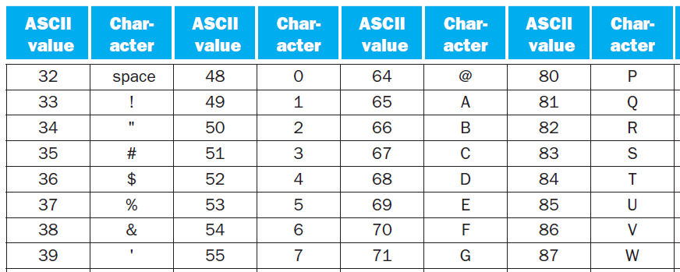
Character Data
Byte-encoded character sets
ASCII: 128 characters: 95 graphic, 33 control
Latin-1: 256 characters (ASCII, +96 more graphic characters)
Unicode: 32-bit character set
Used in Java, C++ wide characters, …
Most of the world’s alphabets, plus symbols
UTF-8, UTF-16: variable-length encodings
Fig. 2.15
Notes:
American Standard Code for Information Interchange (ASCII)
Unicode by default uses 16 bits to represent a character.

Slide 28
RISC-V Byte/Halfword/Word Operations
RISC-V byte/halfword/word load/store
Load byte/halfword/word: sign extend to 64 bits in rd
lb rd,offset(rs1)
lh rd,offset(rs1)
lw rd,offset(rs1)
Load byte/halfword/word unsigned: zero extend to 64 bits
lbu rd,offset(rs1)
lhu rd,offset(rs1)
lwu rd,offset(rs1)
Store byte/halfword/word: store rightmost 8/16/32 bits
sb rs2,offset(rs1)
sh rs2,offset(rs1)
sw rs2,offset(rs1)

Slide 29
String Copy Example for Handling Bytes
C code:
Null-terminated strings
void strcpy(char x[], char y[]){ size_t i; i = 0; while ((x[i]=y[i])!='\0') i += 1; }
Addresses of x, y in x10, x11 (argument registers)
i in x19 (saved register → need to be preserved)
Compiler should actually use registers for temporaries (x5~x7, x28~x31)

Slide 30
String Copy Example
RISC-V code: (pointer version)
strcpy: addi sp,sp,-8 // make space on stack sd x19,0(sp) // save x19 add x19,x0,x0 // x19 = i = 0 L1: add x5,x19,x11 // x5 = addr of y[i] lbu x6,0(x5) // x6 = y[i] add x7,x19,x10 // x7 = addr of x[i] sb x6,0(x7) // x[i] = y[i] beq x6,x0,L2 // exit if y[i] == 0 addi x19,x19,1 // i = i + 1 jal x0,L1 // next iteration of loop L2: ld x19,0(sp) // restore saved x19 addi sp,sp,8 // return space on stack jalr x0,0(x1) // return

Slide 31
How to Load 32-bit Immediates?
I-format only allows 12-bit immediate; what if want to load a 32-bit constant?
Use Load Upper Immediate (lui) + addi
lui rd,constant
Copies 20-bit constant to bits [31:12] of rd
Extends bit 31 to bits [63:32], clears bits [11:0] of rd to 0
U-type
Immediate[31-12]
rd
opcode
20 bits
5 bits
7 bits
lui x19,976 // 976=0x003D0
x19
0000 0000 0000 0000
0000 0000 0000 0000
0000 0000 0011 1101 0000
0000 0000 0000
addi x19,x19,1280 // 1280=0x500
x19
0000 0000 0000 0000
0000 0000 0000 0000
0000 0000 0011 1101 0000
0101 0000 0000

Slide 32
How to Specify Branch Target?
RISC-V Code:
Loop: beq x6,x0,End addi x19,x19,1 jal x0,Loop End:
Branch instructions (SB-type)
But immediate field can only take 12 bits for target address
How to get the full address for the target instruction?
Put address of End here
imm[10:5]
rs2
rs1
funct3
imm [4:1]
opcode
imm[12]
imm[11]
bne x10,x11,2000 // 2000 = 0 0111 1101 0000
0
111110
01011
01010
001
1000
0
1100111

Slide 33
How to Specify Branch Target?
Observation: most branch targets are near, forward or backward
Solution: PC-relative addressing
Use PC to give the 64-bit address and +/- immediate, because most branch targets are near branch instruction, whose address is currently held in PC
12-bit immediate is a signed two’s complement integer to be added to the PC if branch taken
The addresses actually point to halfwords, i.e., target address = PC + immediate × 2 = PC + {imm | 0}
Keep the flexibility of supporting 2-byte instructions in RISC-V, so the branch immediates represent the number of halfwords between the branch instruction and the branch target
Notes:
The 12-bit field in the conditional branch instructions is also a halfword address, meaning that it represents a 13-bit byte address.

Slide 34
How to Specify Jump Address?
Jump and link (jal): UJ-type
rd ← PC + 4; PC ← PC + {imm | 0} (PC-relative)
For long jumps to anywhere, i.e., to 32-bit absolute address
lui: load address[31:12] to a temp register
jalr: add address[11:0] to temp and jump to target
imm[10:1]
imm[19:12]
rd
opcode
imm[20]
imm[11]
5 bits
7 bits
jal x0,2000 // 2000 = 0 0000 0000 0111 1101 0000
0
1111101000
0
00000000
00000
1101111
Notes:
Thus, the 20-bit address field in the jal instruction can encode a distance of ±2^19 halfwords, or ±1 MiB from the current PC.

Slide 35
Target Addressing Calculation
Assume Loop at location 80000
Loop: slli x10,x22,3 | 80000 | 0 | 3 | 22 | 1 | 10 | 19
add x10,x10,x25 | 80004 | 0 | 25 | 10 | 0 | 10 | 51
ld x9,0(x10) | 80008 | 0 | 0 | 10 | 3 | 9 | 3
bne x9,x24,Exit | 80012 | 0 | 24 | 9 | 1 | 12 | 99
addi x22,x22,1 | 80016 | 0 | 1 | 22 | 0 | 22 | 19
beq x0,x0,Loop | 80020 | 127 | 0 | 0 | 0 | 13 | 99
Exit: … | 80024
-20
+12
imm[10:5]
rs2
rs1
funct3
imm [4:1]
opcode
imm[12]
imm[11]
80012: 0000000 11000 01001 001 01100 1100111 → 0 0 000000 0110 0 = +12
80020: 1111111 00000 00000 000 01101 1100111 → 1 1 111111 0110 0 = -20
Notes:
The branch destination relative to the branch instruction in line 3 (12+80012)
The branch instruction on the last line does a backwards branch (−20+80020), corresponding to the label Loop.

Slide 36
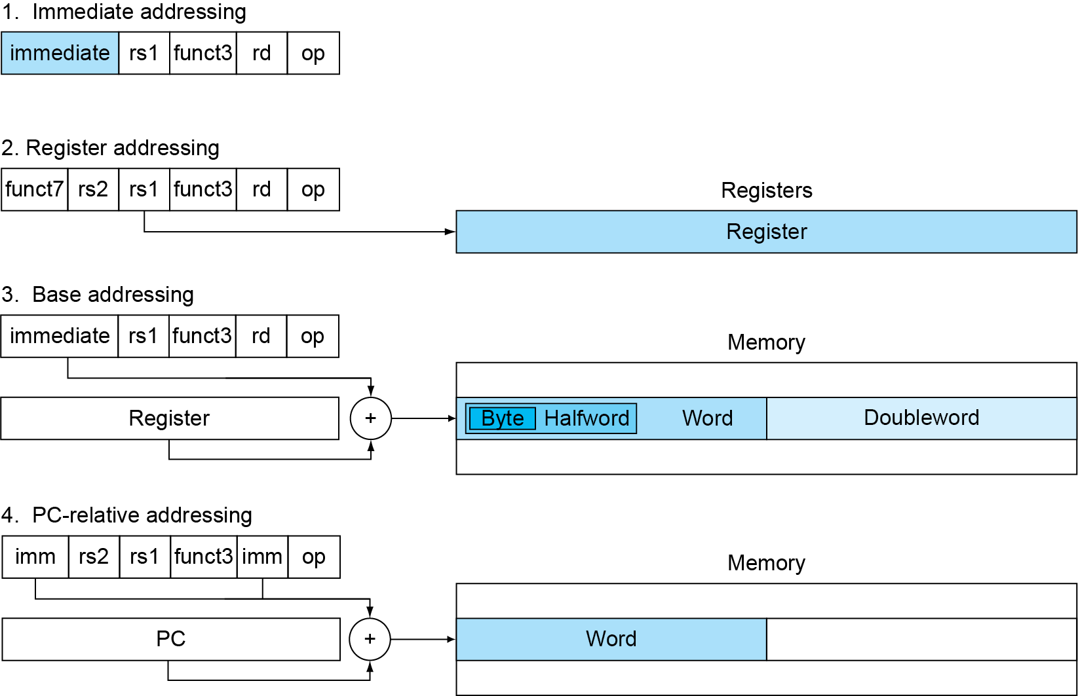
RISC-V Addressing Modes
addi x6,x21,4
Fig 2.17
add x6,x21,x22
sd x6,0(x21)
beq x20,x21,L1

Slide 37
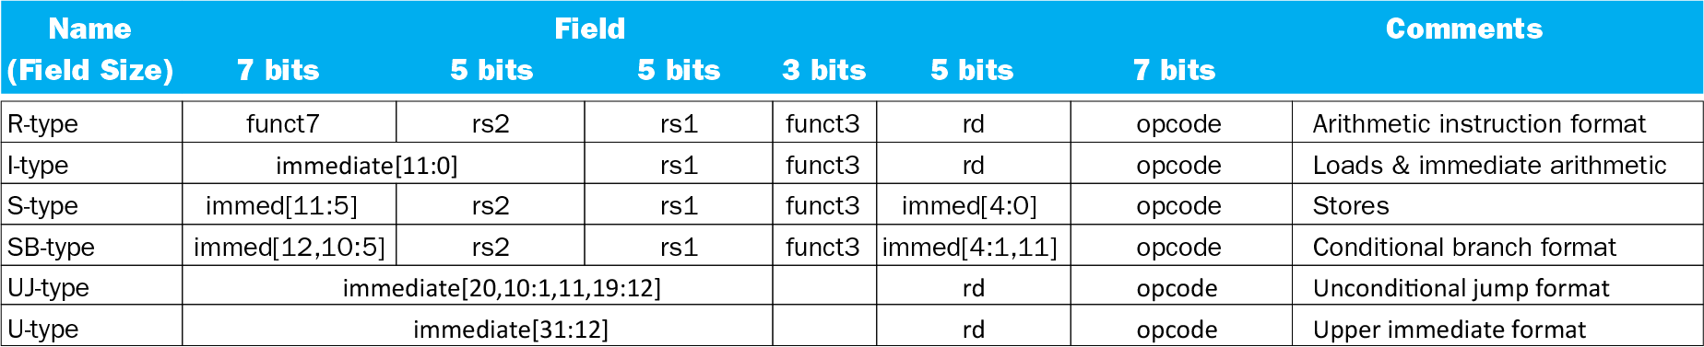
RISC-V Instruction Formats
Fig 2.19
The RISC-V Instruction Set Manual, Volume I: User-Level ISA, Document Version 2.2

Slide 38
Outline
Supporting procedures in hardware (Sec. 2.8)
More operand representations (Sec. 2.9, 2.10)
Characters, wide immediates and addresses
Parallelism and instructions (Sec. 2.11)
Translating and starting a program (Sec. 2.12)
A C sort example to put it all together (Sec. 2.13)
Arrays versus pointers (Sec. 2.14)
Compiling C and interpreting Java (Sec. 2.15)
Other ISAs: MIPS, x86 (Sec. 2.16, 2.17)
The rest of RISC-V (Sec. 2.18)
Fallacies and pitfalls (Sec. 2.19)

Slide 39
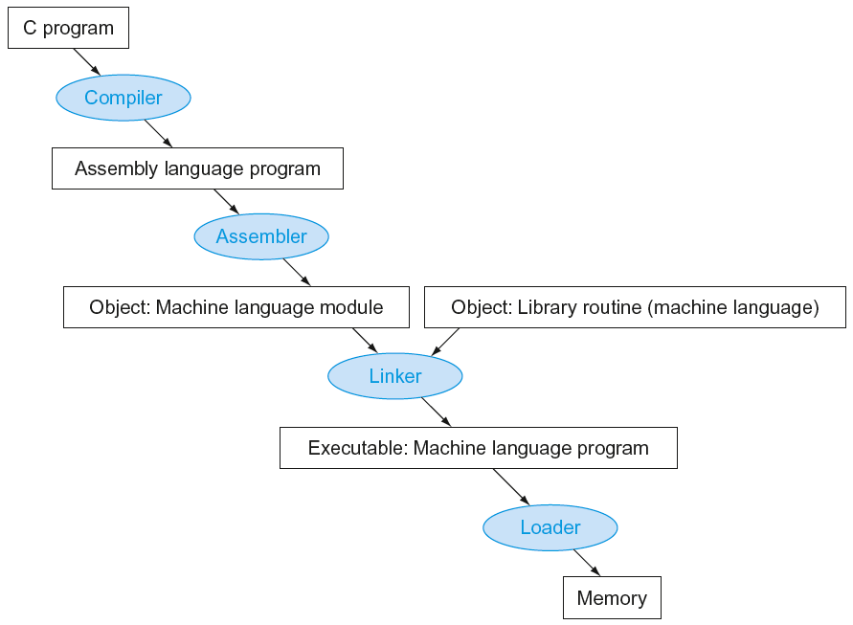
Translation and Startup
Compiler: transforms a C program into an assembly language program, a symbolic form of machine code. Many compilers produce object modules directly
Static linking
Fig. 2.20
Notes:
A high-level language program is first compiled into an assembly language program and then assembled into an object module in machine language. The linker combines multiple modules with library routines to resolve all references. The loader then places the machine code into the proper memory locations for execution by the processor.
Some compilers produce object modules directly, and some systems use linking loaders that perform the last two steps. To identify the type of file, UNIX follows a suffix convention for files: C source files are named x.c, assembly files are x.s, object files are named x.o, statically linked library routines are x.a, dynamically linked library routes are x.so, and executable files by default are called a.out. MS-DOS uses the suffixes .C, .ASM, .OBJ, .LIB, .DLL, and .EXE to the same effect.

Slide 40
Outline
Supporting procedures in hardware (Sec. 2.8)
More operand representations (Sec. 2.9, 2.10)
Characters, wide immediates and addresses
Parallelism and instructions (Sec. 2.11)
Translating and starting a program (Sec. 2.12)
A C sort example to put it all together (Sec. 2.13)
Arrays versus pointers (Sec. 2.14)
Compiling C and interpreting Java (Sec. 2.15)
Other ISAs: MIPS, x86 (Sec. 2.16, 2.17)
The rest of RISC-V (Sec. 2.18)
Fallacies and pitfalls (Sec. 2.19)

Slide 41
Other RISC-V Instructions
Base integer instructions (RV64I)
Those previously described, plus
auipc rd, immed // rd = (imm<<12) + PC
followed by jalr (adds 12-bit immed) for long jump
slt, sltu, slti, sltui: set less than (like MIPS)
addw, subw, addiw: 32-bit add/sub
sllw, srlw, srlw, slliw, srliw, sraiw: 32-bit shift
32-bit variant: RV32I
registers are 32-bit wide, 32-bit operations

Slide 42
Instruction Set Extensions
I: base architecture (51 instructions)
M: integer multiply, divide, remainder (13 instr.)
A: atomic memory operations (22 instr.)
F: single-precision floating point (30 instr.)
D: double-precision floating point (32 instr.)
C: compressed instructions (36 instr.)
16-bit encoding for frequently used instructions

Slide 43
Outline
Supporting procedures in hardware (Sec. 2.8)
More operand representations (Sec. 2.9, 2.10)
Characters, wide immediates and addresses
Parallelism and instructions (Sec. 2.11)
Translating and starting a program (Sec. 2.12)
A C sort example to put it all together (Sec. 2.13)
Arrays versus pointers (Sec. 2.14)
Compiling C and interpreting Java (Sec. 2.15)
Other ISAs: MIPS, x86 (Sec. 2.16, 2.17)
The rest of RISC-V (Sec. 2.18)
Fallacies and pitfalls (Sec. 2.19)

Slide 44
Fallacies and Pitfalls
Powerful instruction ⇒ higher performance
Fewer instructions required
But complex instructions are hard to implement
May slow down all instructions, including simple ones
Compilers are good at making fast code from simple instr.
Use assembly code for high performance
Modern compilers are better at dealing with modern proc.
More lines of code ⇒ more errors and less productivity
Backward compatibility ⇒ instruction set doesn’t change
But they do increase more instructions

Slide 45
Pitfalls
Sequential word or doubleword addresses in machines with byte addressing are not differ by 1
Increment by 4, not by 1!
Keeping a pointer to an automatic variable, e.g., an local array, after procedure returns
e.g., passing pointer back via an argument
Pointer becomes invalid when stack popped

Slide 46
Concluding Remarks
Design principles
1. Simplicity favors regularity
2. Smaller is faster
3. Make the common case fast
4. Good design demands good compromises
Layers of software/hardware
Compiler, assembler, hardware
RISC-V: typical of RISC ISAs
c.f. x86

Slide 47
Supplementary Slides

Slide 48
Outline
Supporting procedures in hardware (Sec. 2.8)
More operand representations (Sec. 2.9, 2.10)
Characters, wide immediates and addresses
Parallelism and instructions (Sec. 2.11)
Translating and starting a program (Sec. 2.12)
A C sort example to put it all together (Sec. 2.13)
Arrays versus pointers (Sec. 2.14)
Compiling C and interpreting Java (Sec. 2.15)
Other ISAs: MIPS, x86 (Sec. 2.16, 2.17)
The rest of RISC-V (Sec. 2.18)
Fallacies and pitfalls (Sec. 2.19)

Slide 49
Assembler: Producing an Object Module
Assembler:
Translates program into machine instructions, determines addresses of labels by symbol table, generates object files
Object file:
Including code and information for building a complete program from pieces and placing code properly in memory
Header: size and positions of various pieces of information
Text segment: translated machine instructions
Static data segment: data allocated for the life of program
Relocation info: for instructions and data words that depend on absolute location of loaded program
Symbol table: global definitions and external refs
Debug info: for associating with source code

Slide 50
Assembler Pseudoinstructions
Most assembly instructions represent machine instructions one-to-one
Pseudoinstructions: assembly instructions defined by the assembler to help assembly programming, but they are not really implemented by the hardware, because they can be realized by true instructions
li x9,123 ➔ addi x9,x0,123
j L1 ➔ jal x0,L1
mv x10,x11 ➔ addi x10,x11,0 and x9,x10,15 ➔ andi x9,x10,15

Slide 51
Linker: Linking Object Modules
Produces an executable image and stores it in a file
Merges object modules by placing code and data modules symbolically in memory
Determine addresses of data and instruction labels using relocation information and symbol table
Patch internal and external references
Determine memory locations that each module will occupy
All absolute references must be relocated to reflect true loc.
Could leave location dependencies for fixing by a relocating loader
But with virtual memory, no need to do this, because program can be loaded into absolute location in virtual memory space
Example in page 128 of textbook
Notes:
Much faster to link individual modules than recompile the whole program

Slide 52
Loader: Loading a Program
Load from executable file on disk into memory
Read header to determine segment sizes
Create virtual address space
Copy text and initialized data into memory (or set page table entries so they can be faulted in)
Set up arguments for main() on stack
Initialize registers (including sp, fp, gp)
Jump to startup routine
Copies arguments to x10, … and calls main()
When main() returns, do exit() syscall

Slide 53
Dynamic Linking
Problems with static libraries
Library routines become part of the executable code → cannot use newer version libraries unless rebuilt
It loads all routines in the library that are called in the executable, even if those calls are not executed
Dynamically linked libraries (DLLs): only link/load library procedures when it is called
Requires procedure code to be relocatable
Avoids image bloat caused by static linking of all (transitively) referenced libraries
Automatically picks up new library versions

Slide 54
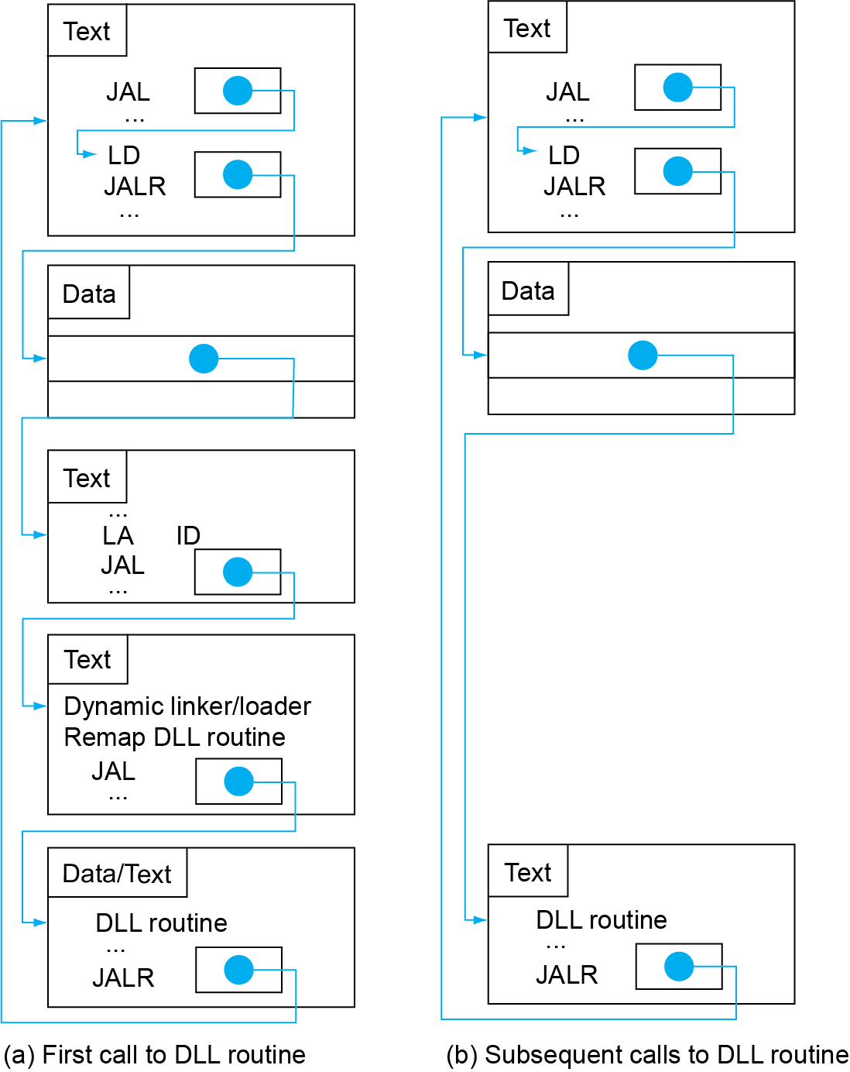
Lazy Linkage
Indirection table
Stub: Loads routine ID, Jump to linker/loader
Fig. 2.21
Linker/loader code
Dynamically mapped code
Notes:
When the procedure is first called, the call loads the address of the stub function and jumps to that stub function. The stub function load information of the library procedure and then jumps to the dynamic linker/loader. The latter loads and links the library procedure into the program and modifies the indirection table to point to that library procedure. Future invocations of that procedure can follow the information in the indirection table to jump to the right library procedure.
The indirection table was prepared by the dynamic linker/loader on program start using external reference information.

Slide 55
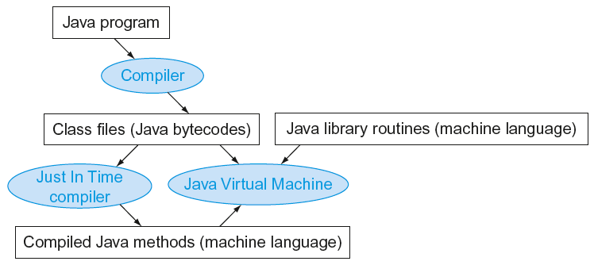
Java: Different Way of Translating/Startup
Simple portable instruction set for JVM
Interprets bytecodes
Compiles bytecodes of “hot” methods into native code for host machine
Fig. 2.23
Notes:
Why Java takes this approach? Portability, efficiency in transferring code over slow network

Slide 56
Outline
Supporting procedures in hardware (Sec. 2.8)
More operand representations (Sec. 2.9, 2.10)
Characters, wide immediates and addresses
Parallelism and instructions (Sec. 2.11)
Translating and starting a program (Sec. 2.12)
A C sort example to put it all together (Sec. 2.13)
Arrays versus pointers (Sec. 2.14)
Compiling C and interpreting Java (Sec. 2.15)
Other ISAs: MIPS, x86 (Sec. 2.16, 2.17)
The rest of RISC-V (Sec. 2.18)
Fallacies and pitfalls (Sec. 2.19)

Slide 57
C Bubble Sort Example: Swap Procedure
void swap(long long int v[], size_t k) { long long int temp; temp = v[k]; v[k] = v[k+1]; v[k+1] = temp;
}
v in x10, k in x11, temp in x5
swap: slli x6,x11,3 // x6 = k * 8
add x6,x10,x6 // x6=v+(k*4) addr of v[k]
ld x5,0(x6) // x5 (temp) = v[k]
ld x7,8(x6) // x7 = v[k+1]
sd x7,0(x6) // v[k] = x7 (v[k+1])
sd x5,8(x6) // v[k+1] = x5 (temp)
jalr x0,0(x1) // return to caller

Slide 58
C Sort Example: Sort Procedure
Non-leaf (calls swap):
void sort(long long int v[], size_t n) {
size_t i,j;
for(i=0; i<n; i+=1)
for(j=i–1; j>=0 && v[j]>v[j+1]; j-=1)
swap(v,j);
}
v in x10, n in x11, i in x19, j in x20

Slide 59
The Outer Loop
Skeleton of outer loop:
for (i = 0; i < n; i += 1) {
addi x19,x0,0 // x19 = i = 0
for1tst:
bge x19,x11,exit1 // exit1 if (i≥n)
{...} // body of "for i"
addi x19,x19,1 // i += 1
beq x0,x0,for1tst // branch to outer loop
exit1:

Slide 60
The Inner Loop
Skeleton of inner loop:
for (j=i−1; j>=0 && v[j]>v[j+1]; j−=1) {
addi x20,x19,-1 // x20 = j = i - 1
for2tst:
blt x20,x0,exit2// if(j < 0), exit loop
slli x5,x20,3 // reg x5 = j * 8
add x5,x10,x5 // reg x5 = v[ ] + (j * 8)
ld x6,0(x5) // reg x6 = v[j]
ld x7,8(x5) // reg x7 = v[j + 1]
ble x6,x7,exit2 // v[j] =< v[j+1], no swap
jal x1,swap // call swap
addi x20,x20,-1 // j -= 1
beq x0,x0,for2tst // check next array element
exit2:

Slide 61
Passing Parameters
Both sort() and swap() need to use arguments stored in x10 and x11 throughout the execution
Solution: copy x10, x11 in sort() to saved registers, x21, x22
add x21,x10,x0 // copy parameter x10 into x21
add x22,x11,x0 // copy parameter x11 into x22
addi x19,x0,0 // i = 0
for1tst: bge x19,x22,exit1
addi x20,x19,-1 // x20 = j = i - 1
for2tst: blt x20,x0,exit2// if(j < 0), exit loop
slli x5,x20,3 // reg x5 = j * 8
add x5,x21,x5 // reg x5 = v[ ] + (j * 8)
ld x6,0(x5) // reg x6 = v[j]
ld x7,8(x5) // reg x7 = v[j + 1]
ble x6,x7,exit2 // v[j] =< v[j+1], no swap
add x10,x21,x0 // prepare 1st swap parameter
add x11,x20,x0 // prepare 2nd swap parameter
jal x1,swap // call swap
addi x20,x20,-1 // j -= 1
beq x0,x0,for2tst // check next array element

Slide 62
Preserving Registers
Preserve saved registers:
addi sp,sp,-40 // make room on stack
sd x1,32(sp) // save x1 on stack
sd x22,24(sp) // save x22 on stack
sd x21,16(sp) // save x21 on stack
sd x20,8(sp) // save x20 on stack
sd x19,0(sp) // save x19 on stack
Restore saved registers:
exit1: sd x19,0(sp) // restore x19 from stack
sd x20,8(sp) // restore x20 from stack
sd x21,16(sp) // restore x21 from stack
sd x22,24(sp) // restore x22 from stack
sd x1,32(sp) // restore x1 from stack
addi sp,sp, 40 // restore stack pointer
jalr x0,0(x1)

Slide 63
Outline
Supporting procedures in hardware (Sec. 2.8)
More operand representations (Sec. 2.9, 2.10)
Characters, wide immediates and addresses
Parallelism and instructions (Sec. 2.11)
Translating and starting a program (Sec. 2.12)
A C sort example to put it all together (Sec. 2.13)
Arrays versus pointers (Sec. 2.14)
Compiling C and interpreting Java (Sec. 2.15)
Other ISAs: MIPS, x86 (Sec. 2.16, 2.17)
The rest of RISC-V (Sec. 2.18)
Fallacies and pitfalls (Sec. 2.19)

Slide 64
Addressing C Arrays
Array indexing in C involves
Multiplying index by element size
Adding to array base address
Can do better by C pointers, for corresponding directly to memory addresses
clear1(long long int array[], size_t size) { size_t i; for (i = 0; i < size; i += 1) array[i] = 0; } | clear2(long long int *array, size_t size) { long long int *p; for (p = &array[0]; p < &array[size]; p = p + 1) *p = 0; }
li x5,0 // i = 0 loop1: slli x6,x5,3 // x6 = i * 8 add x7,x10,x6 // x7 = address // of array[i] sd x0,0(x7) // array[i] = 0 addi x5,x5,1 // i = i + 1 blt x5,x11,loop1 // if (i<size) // go to loop1 | mv x5,x10 // p=addr of array[0] slli x6,x11,3 // x6 = size * 8 add x7,x10,x6 // x7 = address // of array[size] loop2: sd x0,0(x5) // Memory[p] = 0 addi x5,x5,8 // p = p + 8 bltu x5,x7,loop2 //if(p<&array[size]) // go to loop2

Slide 65
Comparison of Array vs. Pointer
Multiply “strength reduced” to shift in both versions
Array version requires shift to be inside loop
Part of index calculation for incrementing i
c.f. incrementing pointer p in the pointer version
Compiler can achieve same effect as manual use of pointers
Induction variable elimination
Better to make program clearer and safer

Slide 66
Outline
Supporting procedures in hardware (Sec. 2.8)
More operand representations (Sec. 2.9, 2.10)
Characters, wide immediates and addresses
Parallelism and instructions (Sec. 2.11)
Translating and starting a program (Sec. 2.12)
A C sort example to put it all together (Sec. 2.13)
Arrays versus pointers (Sec. 2.14)
Compiling C and interpreting Java (Sec. 2.15)
Other ISAs: MIPS, x86 (Sec. 2.16, 2.17)
The rest of RISC-V (Sec. 2.18)
Fallacies and pitfalls (Sec. 2.19)

Slide 67
MIPS Instructions
MIPS: commercial predecessor to RISC-V
Similar basic set of instructions
32-bit instructions
32 general purpose registers, register 0 is always 0
32 floating-point registers
Memory accessed only by load/store instructions
Consistent use of addressing modes for all data sizes
Different conditional branches
For <, <=, >, >=
RISC-V: blt, bge, bltu, bgeu
MIPS: slt, sltu (set less than, result is 0 or 1)
Then use beq, bne to complete the branch

Slide 68
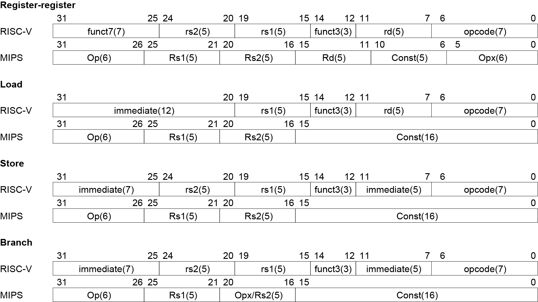
Instruction Encoding

Slide 69
The Intel x86 ISA
Evolution with backward compatibility
8080 (1974): 8-bit microprocessor
Accumulator, plus 3 index-register pairs
8086 (1978): 16-bit extension to 8080
Complex instruction set (CISC)
8087 (1980): floating-point coprocessor
Adds FP instructions and register stack
80286 (1982): 24-bit addresses, MMU
Segmented memory mapping and protection
80386 (1985): 32-bit extension (now IA-32)
Additional addressing modes and operations
Paged memory mapping as well as segments

Slide 70
The Intel x86 ISA
Further evolution…
i486 (1989): pipelined, on-chip caches and FPU
Compatible competitors: AMD, Cyrix, …
Pentium (1993): superscalar, 64-bit datapath
Later versions added MMX (Multi-Media eXtension) instr.
The infamous FDIV bug
Pentium Pro (1995), Pentium II (1997)
New microarchitecture (see Colwell, The Pentium Chronicles)
Pentium III (1999)
Added SSE (Streaming SIMD Extensions) and associated reg.
Pentium 4 (2001)
New microarchitecture
Added SSE2 instructions

Slide 71
The Intel x86 ISA
And further…
AMD64 (2003): extended architecture to 64 bits
EM64T – Extended Memory 64 Technology (2004)
AMD64 adopted by Intel (with refinements)
Added SSE3 instructions
Intel Core (2006)
Added SSE4 instructions, virtual machine support
AMD64 (announced 2007): SSE5 instructions
Intel declined to follow, instead…
Advanced Vector Extension (announced 2008)
Longer SSE registers, more instructions
If Intel didn’t extend with compatibility, its competitors would! → technical elegance ≠ market success

Slide 72
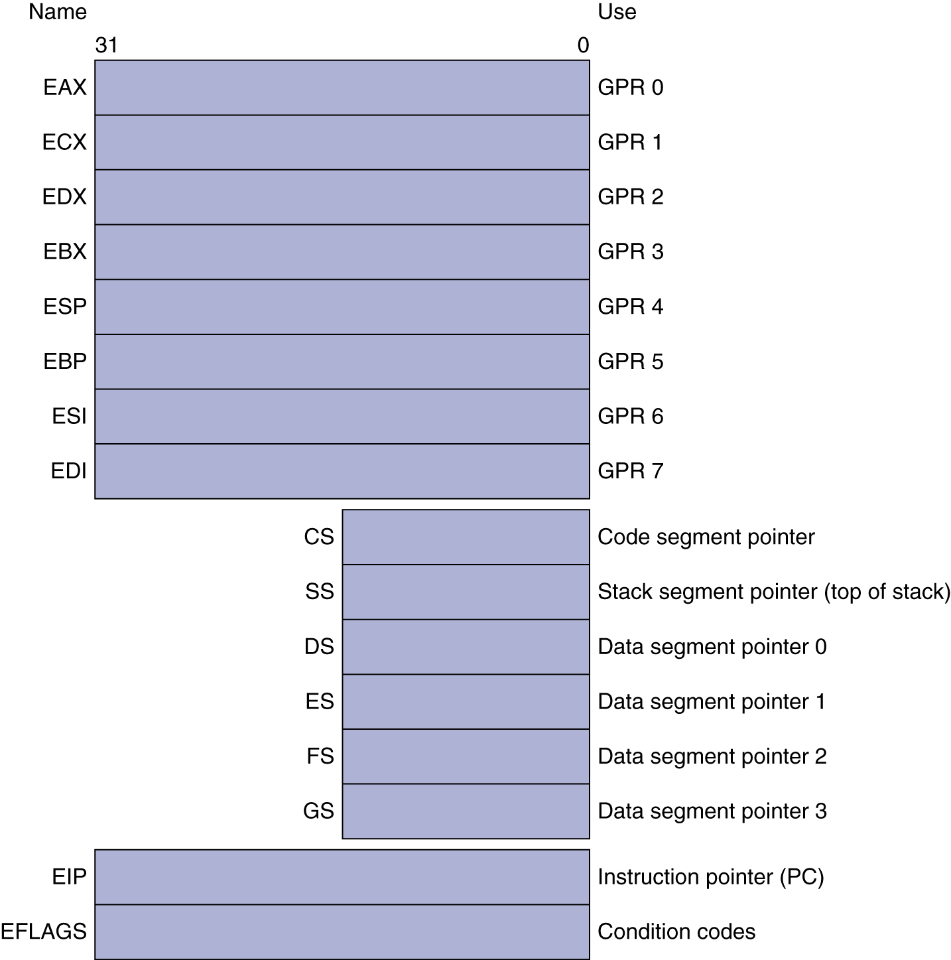
Basic x86 Registers

Slide 73
Basic x86 Addressing Modes
Two operands per instruction
Memory addressing modes: address in register
Address = R_{base} + displacement
Address = R_{base} + 2^{scale} × R_{index} (scale = 0, 1, 2, or 3)
Address = R_{base} + 2^{scale} × R_{index} + displacement
Source/dest operand | Second source operand
Register | Register
Register | Immediate
Register | Memory
Memory | Register
Memory | Immediate

Slide 74
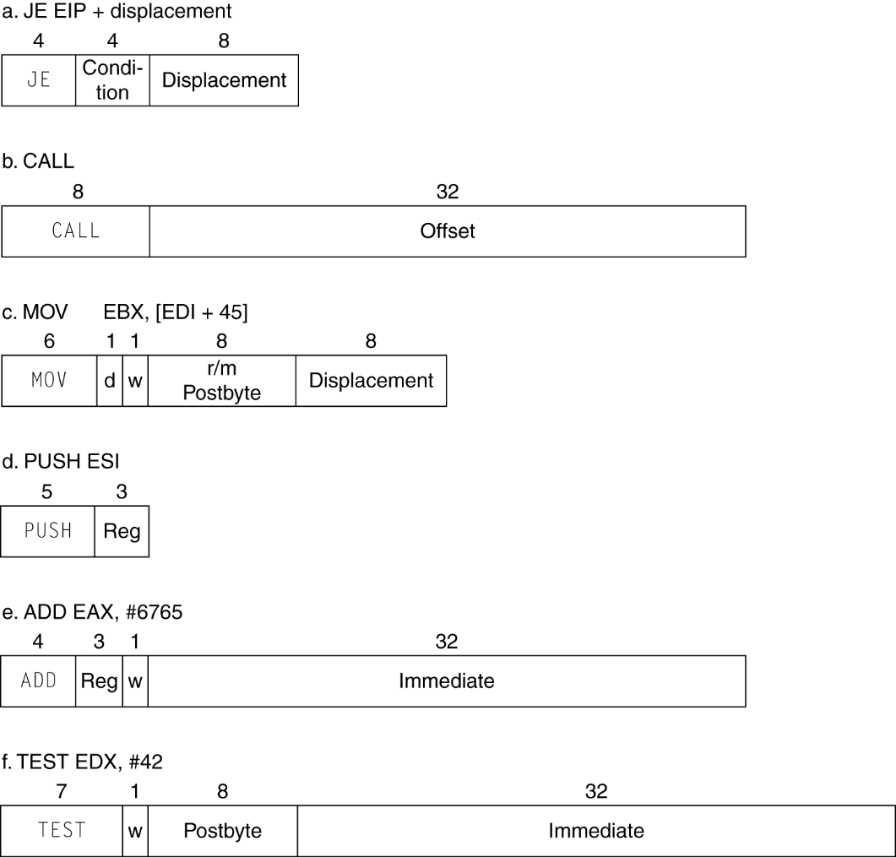
x86 Instruction Encoding
Variable length encoding
Postfix bytes specify addressing mode
Prefix bytes modify operation
Operand length, repetition, locking, …

Slide 75
Implementing IA-32
Complex instruction set makes implementation difficult
Hardware translates instructions to simpler microoperations
Simple instructions: 1–1
Complex instructions: 1–many
Microengine similar to RISC
Market share makes this economically viable
Comparable performance to RISC
Compilers avoid complex instructions

